Slide 1
Modern Data Engineering in the Cloud
PART 3 : Data Engineering with the ETL/ELT -Tool PDI introduction

Slide 2
Data Engineering with PDI
Introductory words
What is Data Engineering?
Motivation and Value Proposition - a historic overview
How does Data Engineering look like in many companies?
What are features and advantages of workflow-based ETL?
Motivation for the use of ETL tools.
Data Engineering and Business Process Automation - similarities and differences

Slide 3
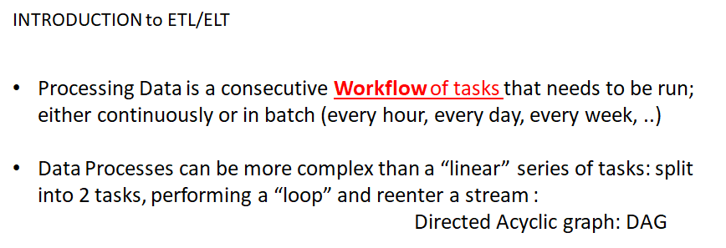
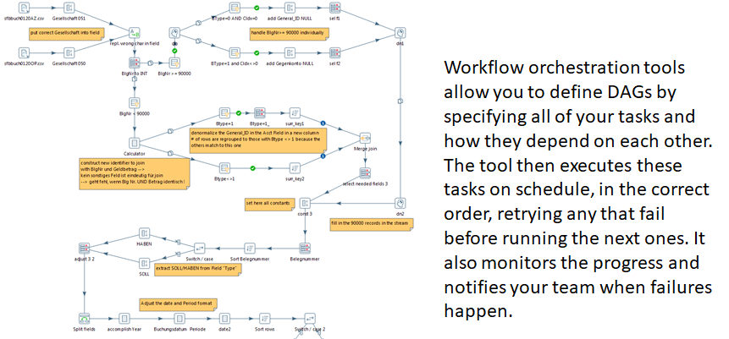
Data Engineering with PDI

Slide 4
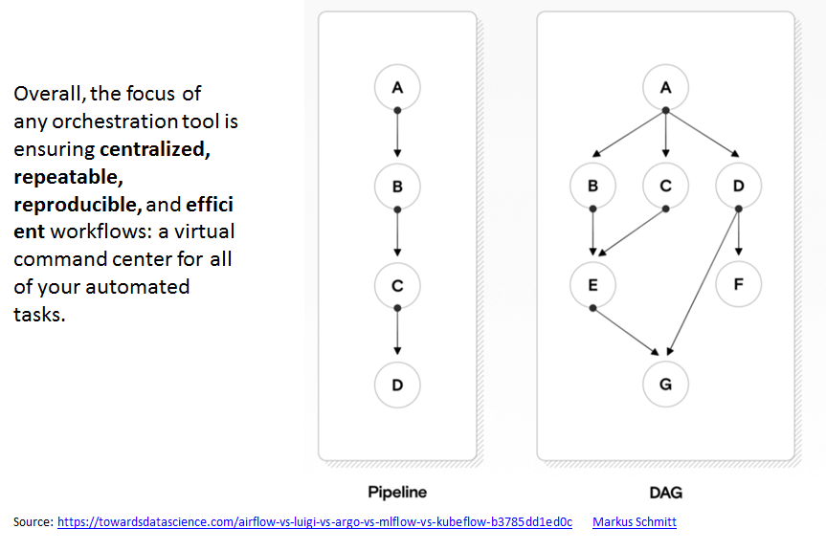
Data Engineering with PDI

Slide 5
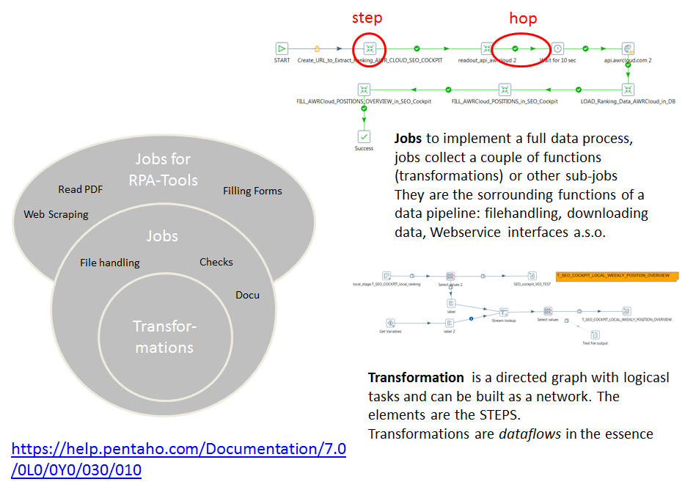
Data Engineering with PDI

Slide 6
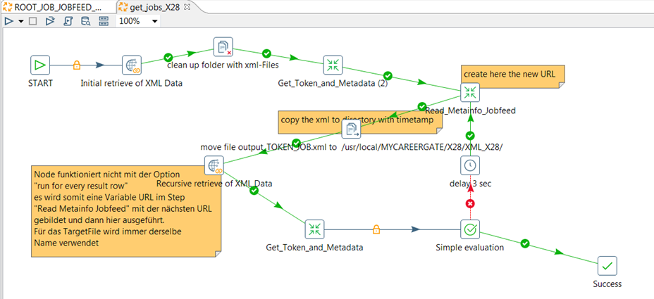
Data Engineering with PDI

Slide 7
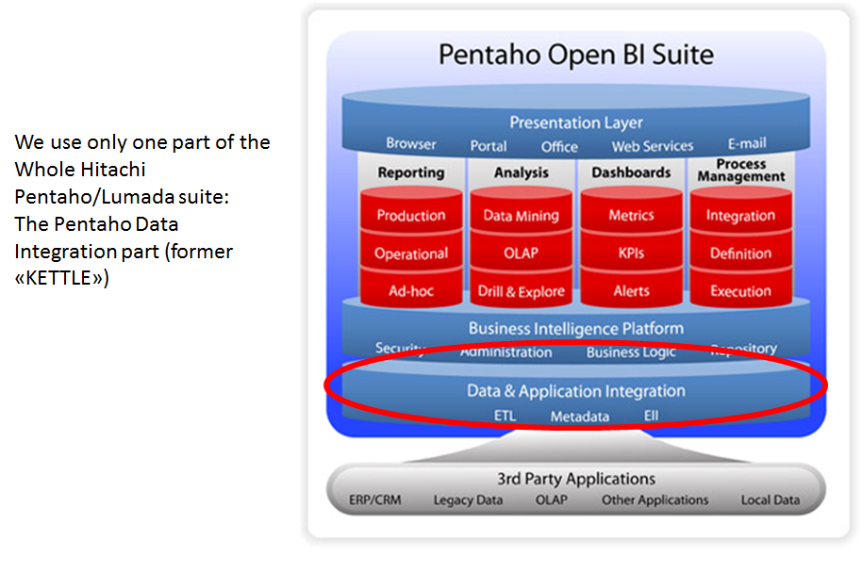
Data Engineering with PDI

Slide 8
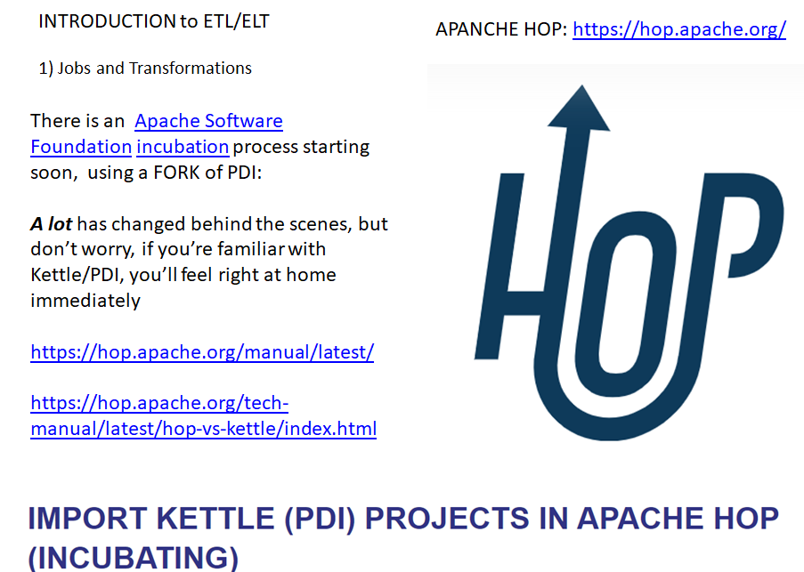
Data Engineering with PDI

Slide 9
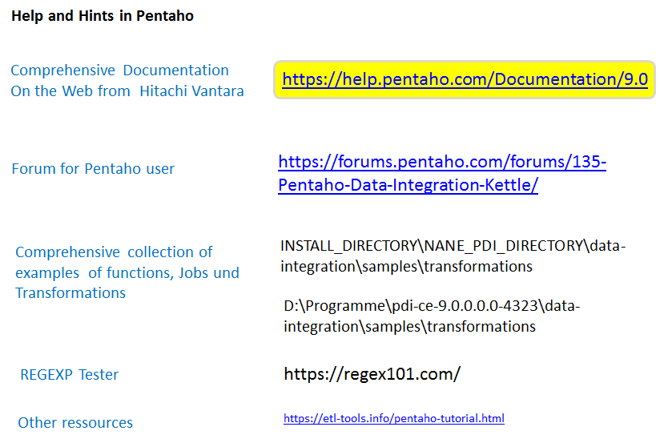
Data Engineering with PDI

Slide 10
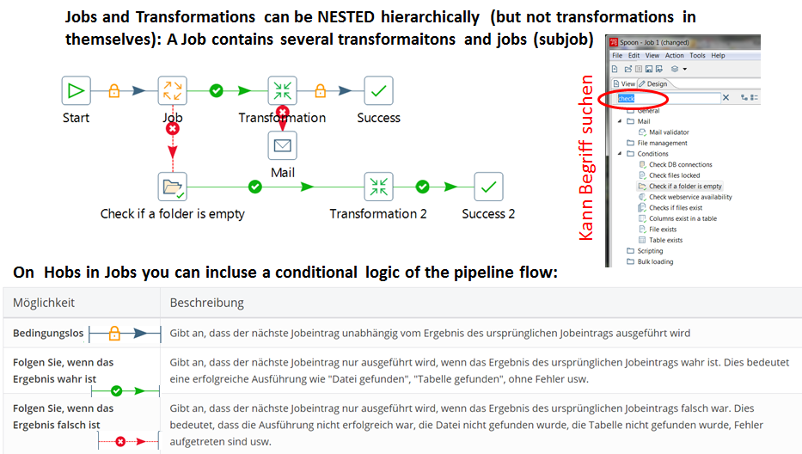
Data Engineering with PDI

Slide 11
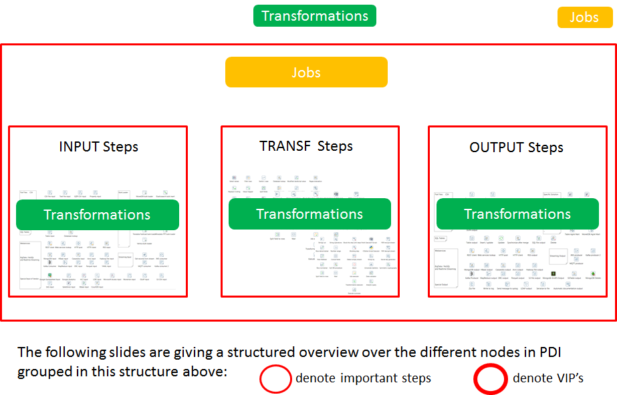
Data Engineering with PDI

Slide 12
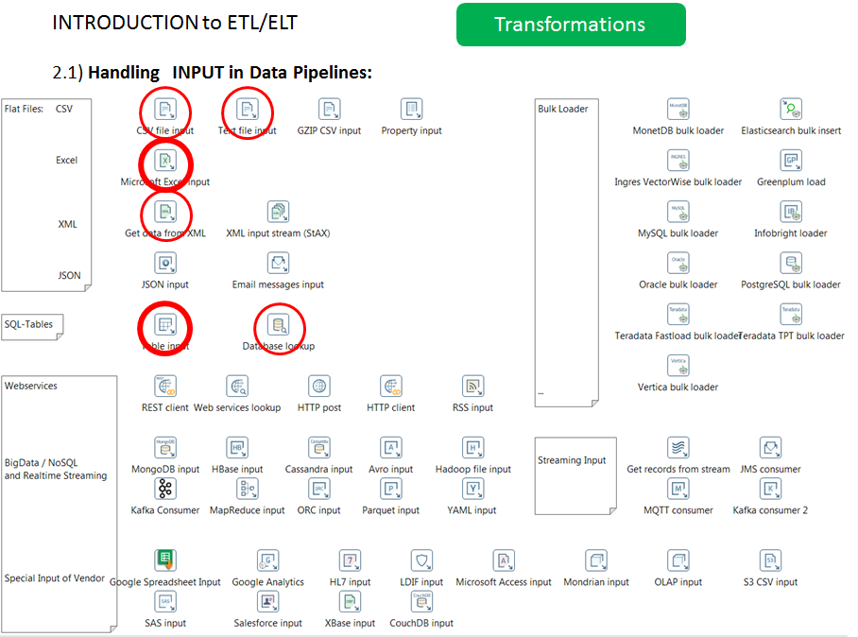
Data Engineering with PDI

Slide 13
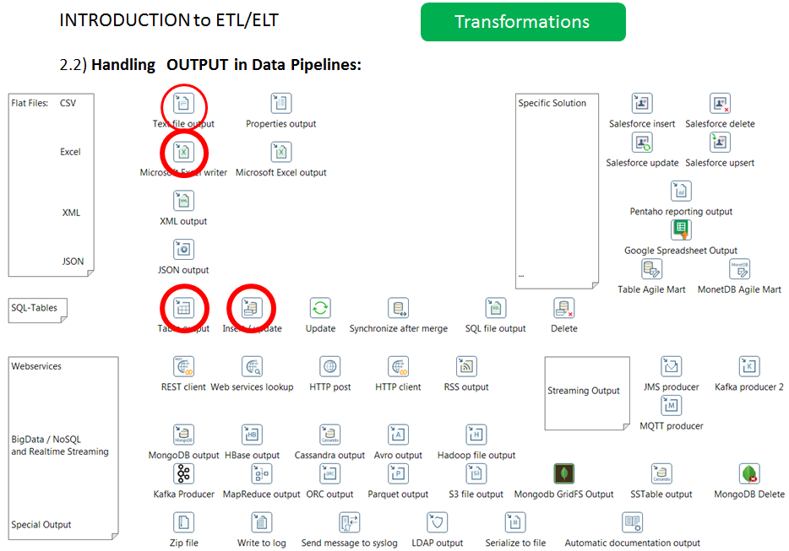
Data Engineering with PDI

Slide 14
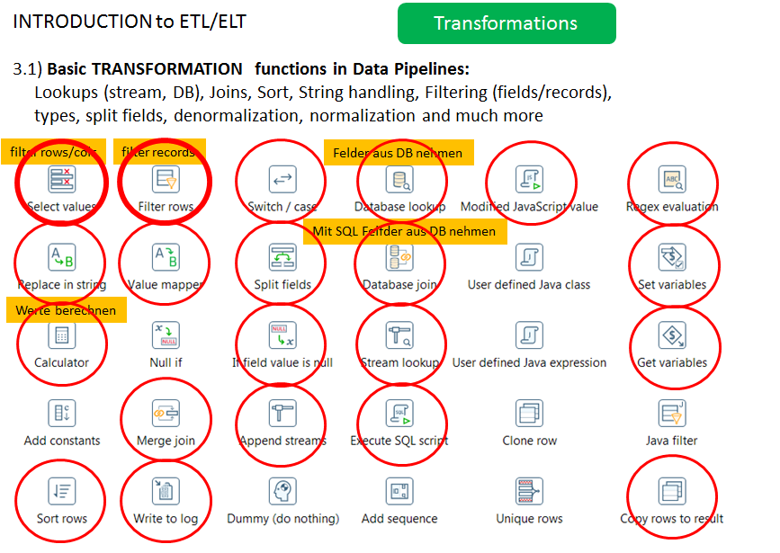
Data Engineering with PDI

Slide 15
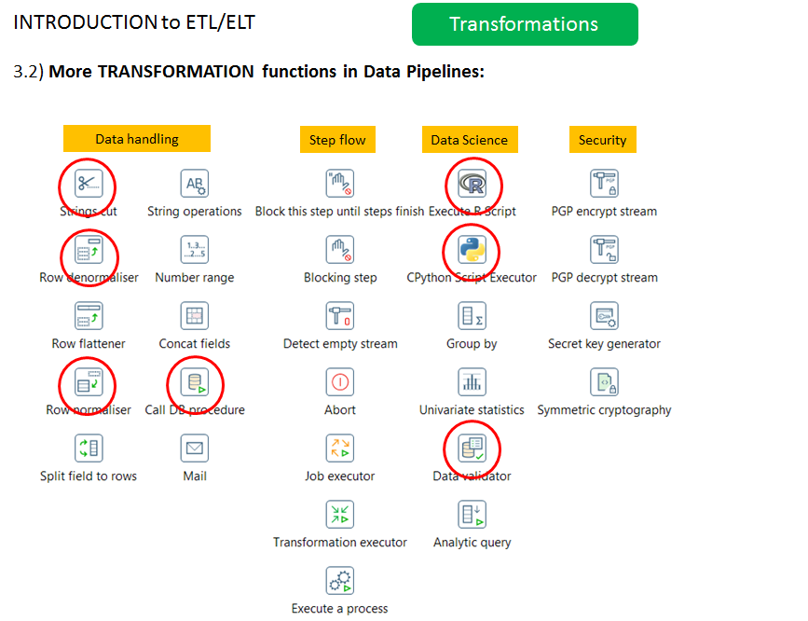
Data Engineering with PDI

Slide 16
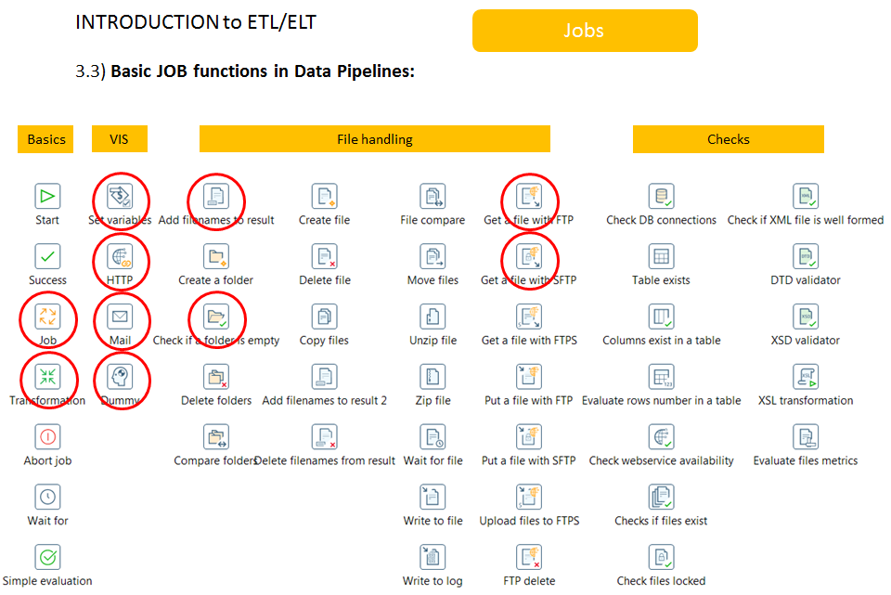
Data Engineering with PDI

Slide 17
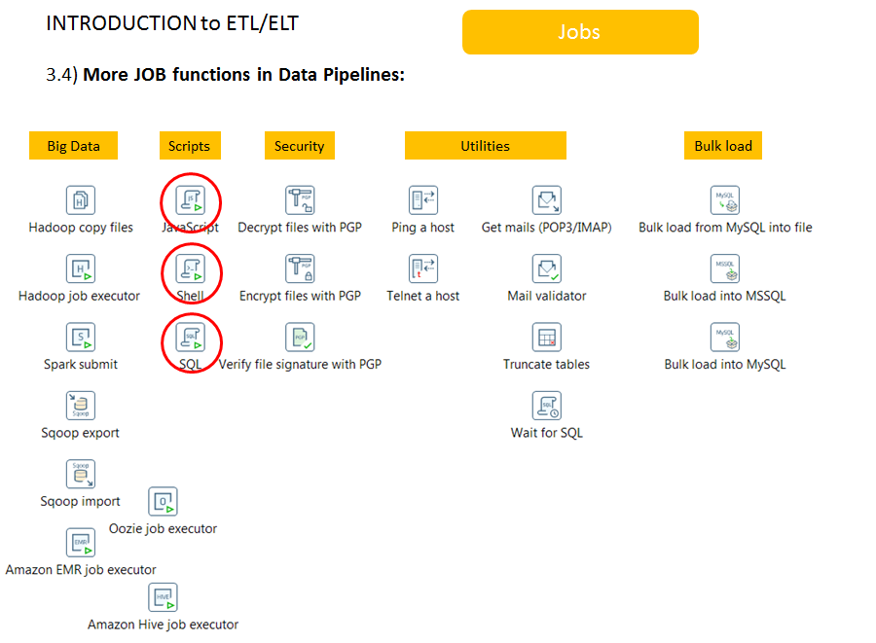
Data Engineering with PDI

Slide 18
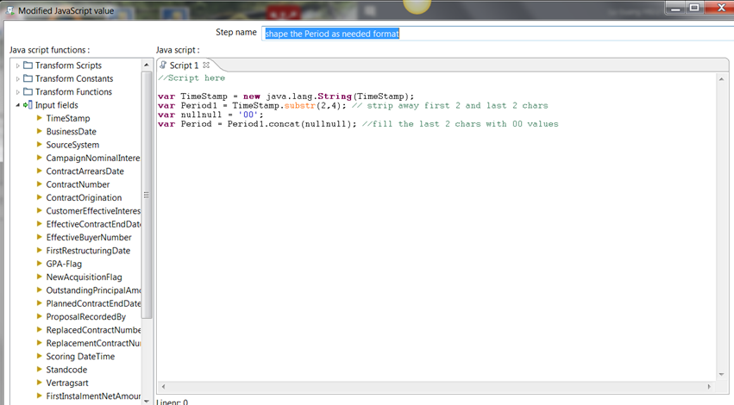
More functions and features with PDI

Slide 19
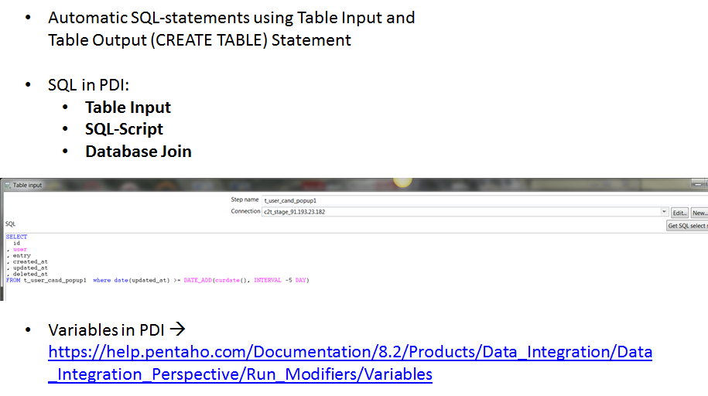
More functions and features with PDI

Slide 20
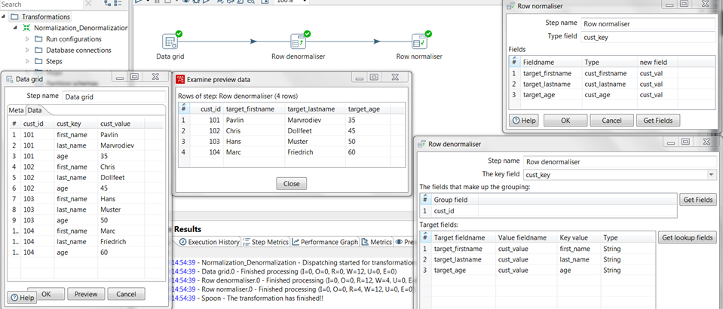
Normalization and Denormalization

Slide 21
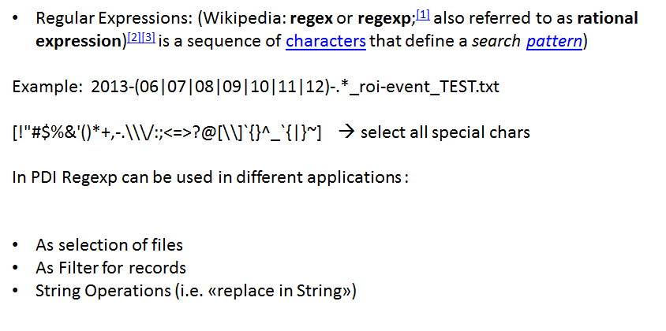
Regular Expression

Slide 22
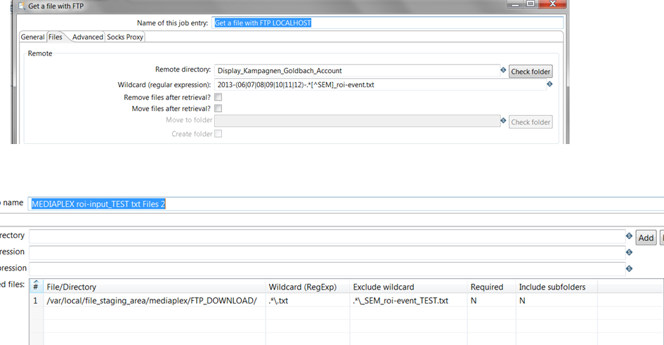
Get File with FTP

Slide 23
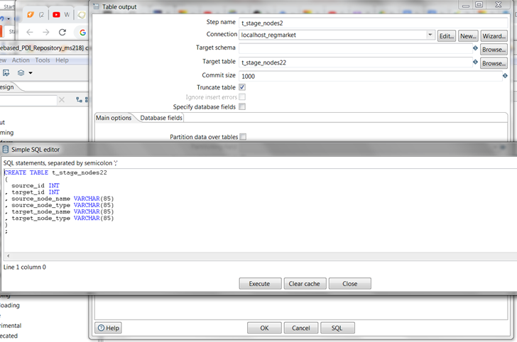
Filling the SQL-statement automatically (CREATE TABLE)

